Slide 1
The Gifts of the Spirit: The Female Diaconate
Its history,
fall into disuse,
and why it all matters
Helen Creticos Theodoropoulos
Valerie Karras
Caren Stayer

Slide 2
What is the diaconate and why is it important?
What does the diaconate look like today?
Should it be more than what we see today? Yes—SO much more!
What is the original purpose of the diaconate and what did deacons do in the life of the Church?

Slide 3
Deacons: Ordained by the Apostles for Service
Acts 6: 1-6: “Now in these days when the disciples were increasing in number, the Hellenists murmured against the Hebrews because their widows were neglected in the daily ministration (diakonia). And the twelve summoned the body of the disciples and said, "It is not right that we should give up preaching the word of God to serve tables. Therefore, brethren, pick out from among you seven men of good repute, full of the Spirit and of wisdom, whom we may appoint to this duty. But we will devote ourselves to prayer and to the ministry of the word.” …These they set before the apostles, and they prayed and laid their hands upon them.”

Slide 4
DIAKONIA: Service / Servanthood
Deacons represent to the Church its calling as servant in the world. They image Christ in His Servant leadership and work. They exemplify the interdependence of worship and service in the Church’s life
The ministry of the deacon embodies the Church’s care for the world; the work of the deacon varies according to what is needed. In the past, this ministry included: care for the widows, orphans and the poor; care for the sick, including bringing the Holy Eucharist to invalids; religious education; administrative duties; and liturgical duties.
The diaconate has always been understood as an essential ministry distinct from priesthood and episcopacy.

Slide 5
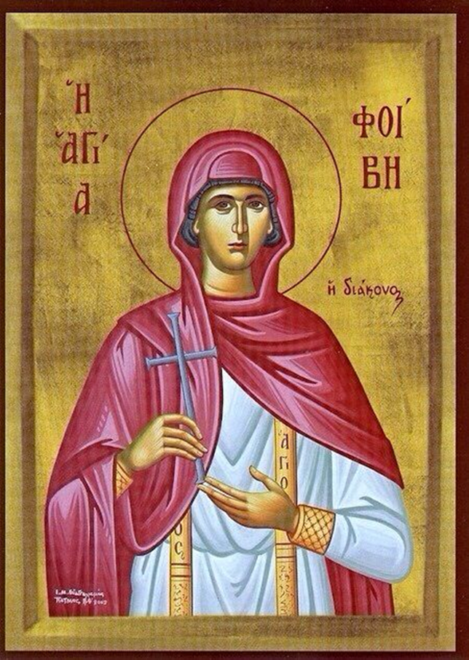
Women as Ordained Deacons in the Life of the Church
From Apostolic Times:
Phoebe: The first witness of the order of women deacons is in Romans 16:1-2: “I commend to you Phoebe our sister, who is a deaconess (diakonos/διάκονος, servant) of the church in Cenchrea.”
**Origen and Chrysostom both interpret the term as “deacon.”
**Phoebe is commemorated on Sept 3 and referred to as a “model deaconess” in Orthodox liturgical texts. In her icon she is often identified as “deaconess,” and is also often shown wearing the diaconal stole

Slide 6
Further evidence of Female Deacons from the earliest days of the Church
1 Timothy 3:11: After a section detailing requirements for deacons, the next passage reads: “Likewise, the women must be reverent, not slanderers, temperate, faithful in all things.”
While some have taken this to refer to the wives of deacons, many scholars argue that the literary format, context and logic of the passage indicate that it is about women deacons. Chrysostom supports this point and says:
Some say he [the Apostle Paul] is talking about women in general, but that cannot be. Why would he want to insert into the middle of what he is saying something about women? But rather, he is speaking of women who hold the rank of deacon. ‘Deacons should be husband of one wife.’ This is also appropriate for women deacons (diakonoi), for it is necessary, good, and right, most especially in the church. (Homily 11 on 1 Tim 3:11)

Slide 7
Historical sources testifying to the female diaconate include:
Pliny the Younger , a pagan writing in about 112, mentions Christian deaconesses in Bithynia
St. Clement of Alexandria (before 215) claims that the female diaconate was necessary and existed since the apostolic period.
Other sources corroborating the presence and work of deaconesses:
Saints’ lives (vitae)
Legislation- canons of local and Ecumenical councils
Writings of the Church Fathers, historians and chronographers; seals, letters; tombstone inscriptions
Church manuals and service order books (euchologia), and monastic rules (typika)

Slide 8
Early church orders - Didascalia Apostolorum (3rd), Apostolic Constitutions (4th), Testamentum Domini (4th-5th) give directions for both “deacon” and “deaconess”
Apostolic Constitutions, Book VIII.19-20: Concerning a deaconess, I Bartholomew make this constitution: O bishop, you shall lay your hands upon her in the presence of the presbytery, and of the deacons and deaconesses, and shall say:—
O Eternal God, the Father of our Lord Jesus Christ, the Creator of man and of woman, who replenished with the Spirit Miriam, and Deborah, and Anna, and Huldah; who did not disdain that Your only begotten Son should be born of a woman; who also in the tabernacle of the testimony, and in the temple, ordained women to be keepers of Your holy gates—do Thou now also look down upon this Your servant, who is to be ordained to the office of a deaconess, and grant her Your Holy Spirit, and cleanse her from all filthiness of flesh and spirit, that she may worthily discharge the work which is committed to her to Your glory, and the praise of Your Christ, with whom glory and adoration be to You and the Holy Spirit for ever. Amen.

Slide 9
Duties of the Deaconess in the Apostolic Constitutions:
Ordain also a deaconess who is faithful and holy, for the ministrations towards women. For sometimes he [the Bishop] cannot send a deacon, who is a man, to the women, on account of unbelievers. You shall therefore send a woman, a deaconess, on account of the imaginations of the bad. For we stand in need of a woman, a deaconess, for many necessities; and first in the baptism of women, the deacon shall anoint only their forehead with the holy oil, and after him the deaconess shall anoint them (III,15)
And let the deaconess be diligent in taking care of the women; but both of them [i.e., deacon and deaconess] ready to carry messages, to travel about, to minister, and to serve, as spoke Isaiah concerning the Lord, saying: "To justify the righteous, who serves many faithfully." Let every one therefore know his proper place, and discharge it diligently with one consent, with one mind, as knowing the reward of their ministration; but let them not be ashamed to minister to those that are in want, as even our "Lord Jesus Christ came not to be ministered unto, but to minister and to give His life as a ransom for many.”(III, 19)

Slide 10
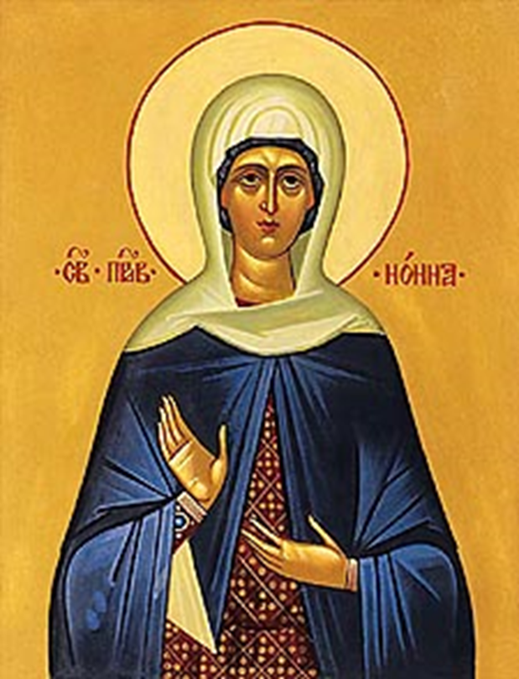
Deaconess Saints
Scholars have found over 40 literary references and 61 inscriptions giving us information on named deaconesses in the Christian East
•At least 23 women saints have been considered deaconesses in the Orthodox church calendar
St Nonna, Mother of St. Gregory the Theologian
St Tatiana of Rome

Slide 11
St. Olympias: Friend of Bishops, Saints, and All in Need
**From one of wealthiest families in the empire; St. Gregory of Nazianzus wrote a poem for her wedding, and St Gregory Nyssa dedicated his Homilies On the Song of Songs to her
**Was made a deacon by Archbishop Nektarios of Constantinople at age 29 (an exception to the canon allowed due to her piety, commitment, and position)
**A strict ascetic, she founded a women’s monastery in Constantinople
**From her personal fortune, she gave money and land lavishly to the poor and sick, and also to the church and clergy; she built a hospital and an orphanage
**Corresponded with and supported her close friend, John Chrysostom, in his exile, and suffered unjust trial, poverty and exile for this devotion.

Slide 12
Deaconesses: Models of Servant Leadership
Other prominent female deacons included Tabitha, Melania the Younger, Macrina, Gorgonia, Sussana, Irene Chrysovolantou, Priscilla, Xenia of Rome, and Romana
Women deacons existed in many churches. Those we know by name were often from prominent families and interacted with the most renowned men of their day but there were also many who were less prominent, such those we know from grave inscriptions
Women deaconesses were often linked to positions of leadership, such as abbesses and the wives of bishops − it was the only ordained office for women
Women deacons often engaged in charitable work, especially among women and children, and often from their own money
These women modeled holiness and servant leadership still relevant to us; they offered prayer, spiritual direction, teaching (especially of other women), self-sacrifice, and charitable outreach. They acted as chaperones and intermediaries, facilitating the work of the Bishop and the priest (and in that role aided the higher clergy liturgically and sacramentally), and assisted in administration and keeping order.

Slide 13
The Female Deacon in the Byzantine Era
The Byzantine Deaconess was ranked with the higher clergy; when the distinction developed between ‘ordained’ (cheirotonia) and ‘consecrated’ (cheirothesia), both the deacon and the deaconess were confirmed through ordination, (cheirotonia, used for the major orders), not consecration (cheirothesia, used for the minor orders).
Justinian’s Novel 6 (6th c.) includes female deacons in his rules for ordinations to the “priesthood” (ἱεροσὐνη) in its broad sense (bishop/presbyter/deacon)
The deaconess’s ordination rite includes the prayer beginning “The divine grace” (Ἡ θεῖα χάρις), which was common to the three major orders of clergy
Byzantine euchologia (service books) always listed the female deacon’s ordination rite immediately after the male deacon’s

Slide 14
Key elements of the ordination rite of the female deacon in the Byzantine period:
Both the deacon and the deaconess were confirmed through ordination, not consecration
Her ordination occurred during the Eucharistic liturgy, at the same point as the male deacon’s (i.e., immediately following the anaphora)
Occurred at the altar, with the bishop’s laying on of hands and his reading of two prayers; the prayers include God’s call to the ordinand and an epiklesis
She was vested with the orarion crossed in the same way as the subdeacon’s, which is how the deacon wears it at Holy Communion
After receiving the Eucharist from the bishop at the altar, she was given the chalice and she herself replaced it on the altar

Slide 15
1st Byzantine Prayer for the Ordination of the Female Deacon
O God, the Holy and almighty, who sanctified woman through the birth in the flesh of your only-begotten Son and our God from the Virgin; and bestowed the grace and advent of your Holy Spirit not to men alone but also to women; look now, Lord, upon this your servant and call her to the work of your diaconate, and send down upon her the abundant gift of your Holy Spirit; preserve her in the Orthodox faith, in blameless conduct, always fulfilling her ministry according to your pleasure; because to you is due all glory and honor … .
•Barberini 336 codex, 163.3 (8th c.)

Slide 16
2nd Byzantine Ordination Prayer for the Female Deacon
Sovereign Lord, You who do not reject women offering themselves and wishing to minister in your holy houses in accordance with what is fitting, but receive them into an order of ministers; bestow the grace of your Holy Spirit also upon this your servant who desires to offer herself to you, and fill her with the grace of the diaconate, as you gave the grace of your diaconate to Phoebe, whom you called to the work of ministry… (Barberini 336 codex, 164.10 (8th c.))

Slide 17
What can these historic Ordination Prayers tell us about why she was ordained?
Women as well as men are sanctified and set apart for service. The deaconess is graced by the power and presence of the Holy Spirit to accomplish the work of service—holy diakonia—to which she has been called.
Ordination establishes the deaconess in unity with the faith, and keeps her in the truth, by placing her under the spiritual and ecclesiastical authority (the omophorion) of the Bishop.
With ordination, the deaconess is incorporated into the life of the Church, the life of the Church is sealed into the life of the deaconess, and the service she gives to the Church becomes the presence of the Church in outreach to those in need.
With ordination her ministry is given Episcopal oversight and support and there is accountability on both sides.

Slide 18
Historically, Why did the Church have Female Deacons?
Pastoral imperative: the need to minister to the women faithful in the church. Socio-cultural issues, specifically seclusion of women and the restriction of women to the private arena of the home, affected the church’s ability to fulfill its pastoral responsibilities to women. Also, to ensure the safeguarding of virginity, to protect female modesty, and for moral propriety. Their ministry also extended to children, who were under the direction of women in the home.
While female deacons originally served in parishes, later they were predominantly nuns (especially abbesses). Within female monasteries they assisted with liturgical duties.

Slide 19
Functions of the Female Deacons
Assisted with the baptism of adult women, including performing the actual anointing (church orders)
Catechized women, and then instructed newly baptized women in the faith (Didascalia)
Chaperoned women’s meetings with male clergy (Apostolic Constitutions)
Kept order in the women’s section of the church (Apostolic Constitutions)
Chanted at services (e.g., matins at Hagia Sophia – travel diary of Anthony of Novgorod, 12th c.)
Took the Eucharist to homebound women (Didascalia Apostolorum, also noted by St Photios in letter to a bishop)
Served as abbesses and liturgical leaders in women’s monasteries

Slide 20
Why did the Female Diaconate fall into disuse? Various theories suggest:
Decline in the number of adult female converts
Greater circumscription of the public activity of women
The increasing importance of Levitical ritual impurity in the Byzantine Church, with the perception that the shedding of blood rendered a woman unclean. Restrictions on menstruating women in worship began in the 8th-11th cent. It should be noted this is in direct contrast to the understanding of “uncleanness” in early Christian documents that explicitly rejected the idea of ritual impurity based on normal bodily functions.
Shift in scope and activities of the other orders of the clergy
Decline of the male diaconate and its role and function
Shift of the duties of the female diaconate from parishes to monasteries
Increase of State control over social welfare

Slide 21
What can the Historic diaconate tell us about a renewed diaconate today?
Review of the historic mission of the diaconate provides a model and guide for today’s diaconate, not a list of specific functions that must be copied.
Male and female deacons traditionally and in a special way were attached to the Bishop, and so their duties and ministries will vary according to the direction of their Bishop, the needs of the particular pastoral context, and their specialized training and talents. In today’s world, we have a new opportunity to merge the training and gifts of men and women in various fields of service to the Church’s ministry
Notes:
They may be appointed to specifically assist at a particular parish; or may serve multiple parishes at the diocesan level; or may be attached to a specific institution such as a monastery, hospital, extended care facility, a shelter or group home; or may be attached to the work of a particular Bishop or priest (in, for example, the missionary field)

Slide 22
What does the historical diaconate say about the ministry of both male and female deacons today?
Preaching the Word
Mission
Catechesis and higher religious education
Work with the youth
Ministry to the sick and the dying
Ministry to the elderly or isolated
Assistance for the poor
Administration
Represent the Bishop at various gatherings, conferences, and symposiums
Liturgical ministry

Slide 23
Historically the female deacon assisted with the needs of women. How might she help in this way today?
The presence of the female deacon can protect, support and expand the ministry of the priest and Bishop in cases of:
Domestic abuse
Sexual abuse, assault and rape
Sexual trafficking/ Prostitution
Infertility
High risk/ difficult pregnancy
Miscarriage
Unexpected or unwanted pregnancy
Abortion
Illnesses uniquely impacting women
Notes:
Having a female deacon as the face of the loving Church to guide women going through uniquely female crises would certainly build up the body of Christ by helping women stay on the righteous path in a way that glorifies God. E.G., a woman who has fallen into sexual sin and can’t find her way back to the Church, terrified to confess to her priest. A pregnant teen. A woman traumatized by rape who cannot bear to be alone with a man. A woman who has been diagnosed with breast cancer and wonders if her husband will ever see her as a woman once surgery and chemo have so altered her. What about ministry to women in prison? Although some women can and do turn to priests for guidance in theses situations, many will not. We simply don’t see the ones who are afraid, or ashamed, or too traumatized to show up. We have to see them, hear them, minister to them, offer them healing. Women to women ministry can meet these unmet needs. Again, this is not to sidetrack the priest; through the care, service and guidance of the deaconess the woman can be incorporated back into the life of the Church, and guided to the priest for sacramental participation.

Slide 24
Why the History of the Female Diaconate Matters:
We see that the female diaconate is not a new thing but rather a valid ministry authentic to the life of the Church. It belongs to the Church, and does not come to it through the imposition of a foreign ideology. To deny or repudiate the female diaconate is to distort the authentic voice and experience of the Church, and denies the Church her own history, life, and proper form.
This history makes manifest that women as well as men were graced by the Holy Spirit with sacramental ordination to the ministry of the diaconate. We cannot disparage what the Spirit has given, or claim that it was given only for a specific time and that He no longer offers what He has before bestowed upon the Church, for that would be to lose faith in the working of the Spirit.
The ministry of diakonia is central to the life of the Church; its decline is truly our loss, and its renewal in all its fullness- male and female – is essential to fulfill the work of the Church.

